Slide 1

Tagetik Reporting Training
Zhongdi Wang
Oct 6, 2025

Slide 2
Training contents
Overview of usage of Excel formulas & Advanced script
Demo 1 & Exercise 1 (Usage of Excel formulas & Cell fields)
Demo 2 & Exercise 2 (Usage of OriginalScenario & ConsolidationScenario)
Demo 3 & Exercise 3 (Usage of This,Lowest,Select,Getnode & Getleaf)
Break
Demo 4 & Exercise 4 (Usage of OrFilter)
Demo 5 & Exercise 5 (Usage of IF function & Parameter recall)
Demo 6 & Exercise 6 (Usage of Advanced Dynamicity in parameters)
Q&A

Slide 3
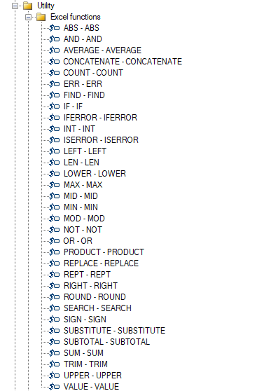
Overview of Advanced reporting
Usage of Excel formulas
Tagetik supports most Excel functions, which can be used directly within the matrix to perform dynamic calculations

Slide 4
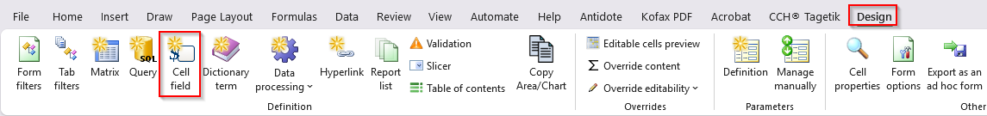
Demo 1 (Usage of Excel formulas & Cell fields)
Tagetik supports most Excel functions, which can be used directly within the matrix to perform dynamic calculations
Function of cell fields allows to view the desired attributes related to the dimension used in the form

Slide 5
Exercise 1 (Usage of Excel formulas)
Open report EXE_1 under the folder 040_TRAINING -> EXERCISE -> EXE_1
Add an additional column which converts the amount in CAD to USD only for the account starting with “57”, otherwise keep the original amount in CAD.
Add 3 cell fields on the cells E3,E4 & E5 based on the headers on column D
The rate from CAD to USD is stored in cell N2
Column E contains the Account code
Run the report using the below parameters:
- Scenario: 2024ACT_CAD
- Category: 999
- Period: 12

Slide 6
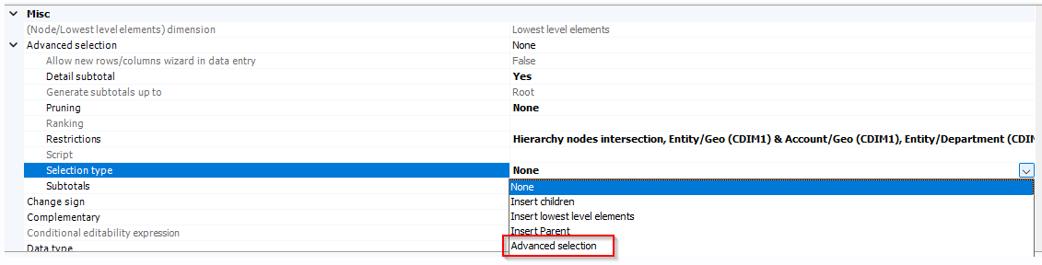
Overview of Advanced reporting
Usage of Advanced script
Advanced dynamicity allows to create highly flexible and responsive reports using dynamic formulas, structures, and drivers. This enables users to adapt reporting layouts and calculations based on changing data contexts, improving automation and analytical depth

Slide 7
Demo 2 (Usage of OriginalScenario & ConsolidationScenario)
Element | Description | Description
Syntax | consolidationScenario | originalScenario
Attributes | code desc | code desc
Value returned | If applied to an original scenario, it returns the associated consolidation scenario or set of consolidation scenarios. If applied to a consolidation scenario, it returns the same scenario. | If applied to a consolidation scenario, it returns the associated original scenario. If applied to an original scenario, it returns the same scenario.

Slide 8
Exercise 2 (Usage of OriginalScenario & ConsolidationScenario)
Open report EXE_2 under the folder 040_TRAINING -> EXERCISE -> EXE_2
Convert the actual scenario to the consolidated scenario on CAD (2023ACT_CAD) on the 2nd scenario on the column filter
Convert the actual scenario to the consolidated scenario on USD (2023ACT_USD) on the 3rd scenario on the column filter
Run the report using the below parameters:
- Scenario: 2023ACT
- Period: 12
- Entity: 900_PHX
- Category: 999

Slide 9
Demo 3 (Usage of Function This, Lowest, Select, Getnode & Getleaf)
Element | Description | Description | Description | Description
Syntax | this | lowest | select (field, operator, value) | getLeaf(code), getNode(code)
Value returned | Node specified in the row/column filters tree to which advanced selection has been applied | Gives all the lowest level elements of the selected node | Elements of the set that satisfy the condition defined via the three parameters (field, operator, value) | Leaf or node, with the code indicated as parameter, in the same hierarchy as the node to which the functions are applied

Slide 10
Exercise 3 (Usage of Function This, Lowest, Select, Getnode & Getleaf)
Open report EXE_3 under the folder 040_TRAINING -> EXERCISE -> EXE_3
Add an advanced script on the Dimension Account (On the row filter) to display the below accounts:
  Display all the lowest level accounts under Node “10000”
  Display all the lowest level accounts starting with “30” under Node “34999” but exclude account “3005”
Run the report using the below parameter:
- Scenario: 2024ACT_CAD

Slide 11

See you in 10 minutes

Slide 12
Demo 4 (Usage of Function OrFilter)
Element | Description
Syntax | OrFilter
Value returned | A single filter obtained by combining, with OR relationships, elements processed as parameters

Slide 13
Exercise 4 (Usage of Function OrFilter)
Open report EXE_4 under the folder 040_TRAINING -> EXERCISE -> EXE_4
Add an advanced script on the Dimension Account (On the row filter Line 1) to display the total sum of accounts excluding account “1000” & “1100”
Run the report using the below parameter:
- Scenario: 2024ACT_CAD

Slide 14
Demo 5 (Usage of Function IF & Parameter recall)
Element | Description | Description
Syntax | IF(condition) THEN (result) ELSE IF (condition) THEN (result) | @code of parameter.code/desc
Value returned | Return different result based on the conditions under IF statement | Refer to the value of the parameter used in the script

Slide 15
Exercise 5 (Usage of Function IF)
Open report EXE_5 under the folder 040_TRAINING -> EXERCISE -> EXE_5
An Account parameter $VOC_100_P is used on the report
Add an advanced script on the Dimension Entity (On the row filter) to display the below:
  If Account node “50999” is selected then display the lowest elements of node “1000_PTSI_TOT”
  If Account node “60999” is selected then display the lowest elements of node “2000_PTSUSA_TOT”
Run the report using the below parameter:
- Scenario: 2024ACT_CAD
- Account: 50999 OR 60999

Slide 16
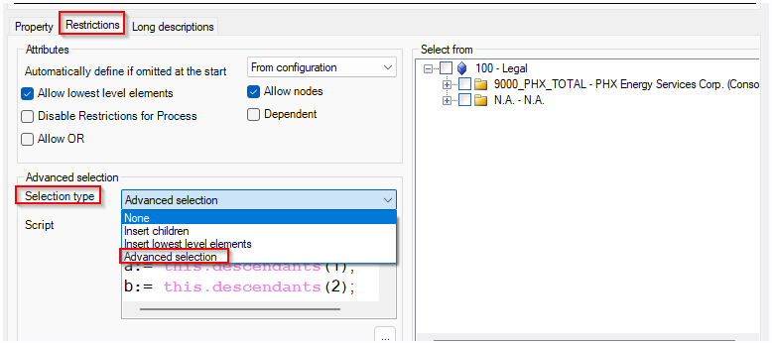
Demo 6 (Usage of Advanced Dynamicity in parameters)
Advanced dynamicity can be used on the Report parameter as well to customize the items which can be selected while running reports.

Slide 17
Demo 6 (Usage of Advanced Dynamicity in parameters)
Element | Description
Syntax | Descendants(descLevel)
Value returned | Returns the elements and/or sub-nodes of the node of entities on which it is applied. The sub-nodes are at the level indicated by descLevel

Slide 18
Exercise 6 (Usage of Advanced Dynamicity in parameters)
Open report EXE_6 under the folder 040_TRAINING -> EXERCISE -> EXE_6
An Entity parameter ENT_TRAINING is created and used on the report
Update the advanced script used on ENT_TRAINING to display the below:
  Be able to select the root node
  Be able to select all the nodes 1 level down from the root node “100” except node “N.A.”
  Be able to select all the nodes 1 level down from the node “9000_PHX_TOTAL”

Slide 19
Q & A

